Slide 1
Mid-Course Review
Front-End Web Development

Slide 2
Rover
Mid-Course Review Lab

Slide 3
Rover
120 minutes
It’s time to review what we’ve learned so far and combine all of our new skills by designing a responsive, interactive site called Rover. Your goal is to add CSS and JavaScript so that the site matches the provided screenshots and has the functionality requested in the JavaScript file.
Remember: Use your resources, ask questions, try things one step at a time, and don’t give up!
Starter / solution code: https://drive.google.com/drive/folders/18lIcF22YmViOQJ_YUgnjrWvjc7UhjxFF?usp=sharing

Slide 4

Identifying the Sections
As we did with the Airbnb Layout Lab, let’s break the site down into sections that we can focus on one by one:
Header
Hero Container
Facts Container
Action
1-2-3 Steps

Slide 5

The Header
We see two subsections of content in the header.
What content is hidden when the screen size is smaller?
What property value would we change to hide those elements?

Slide 6

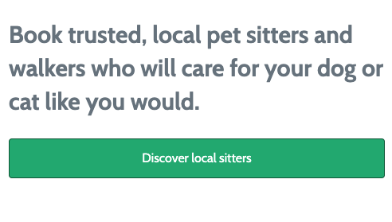
2. Hero Container
Here, we see a background image, and then content on top of the image.
Try creating the element with the image first, then adding content inside of that element.
What do we need to adjust at a smaller screen size?

Slide 7
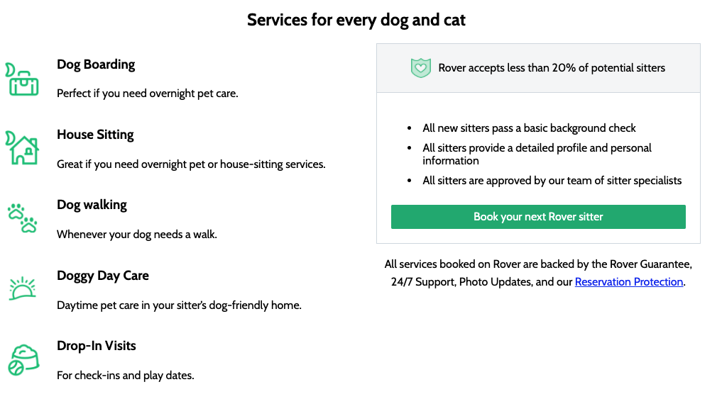
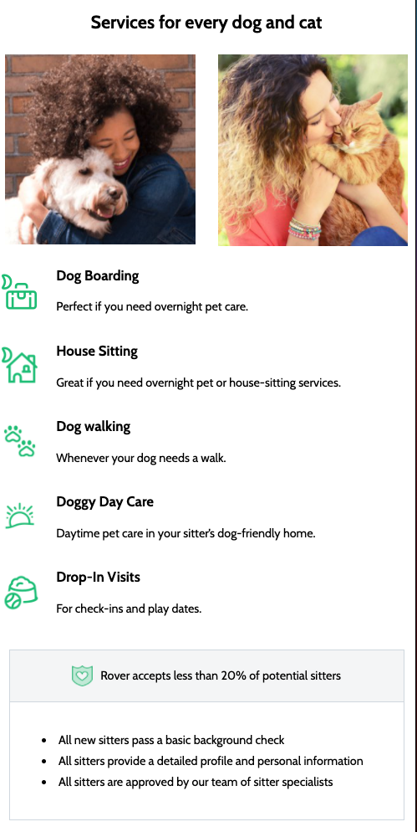
3. Facts Container
Focus on creating the two column layout:
In the first column, you have 5 child elements with the same layout.
In the second column, you’ll need several child elements for background color, spacing and borders.

Slide 8
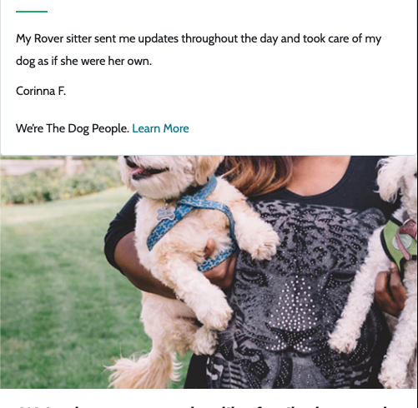
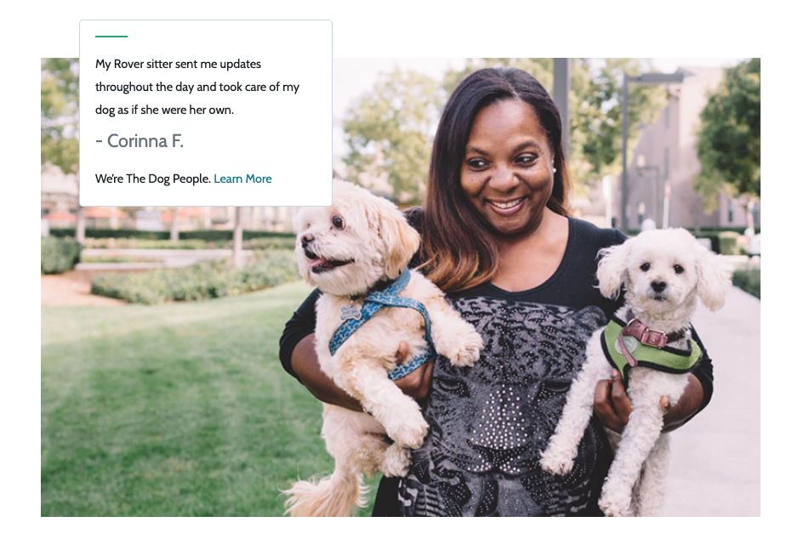
4. Action
In the mobile layout, the two elements are stacked.
In the larger screen layout, the testimonial is positioned on top of the image.
How can we position the testimonial like this?

Slide 9
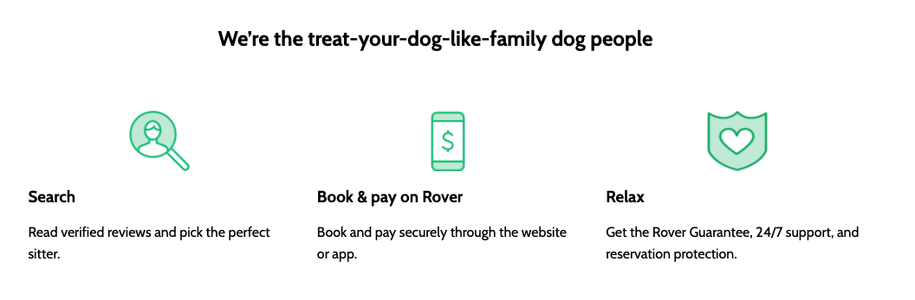

5. 1-2-3 Steps
There’s some sort of heading at the top.
Three columns, each with the same layout:
How do the columns change layout as the screen size adjusts?
What property value would we change to go from a flex row layout to a flex column layout?

Slide 10
Final Project Checkpoint
10 Minutes
This is a good place to start thinking about what you want to work on for your final project. Don’t wait until the last week!
Here are some questions for consideration:
What are you thinking of building for your final project?
Do you have ideas on the JS functionality you want to include?
What do you think will be the most difficult part of your project?
If you had more time to work on the project, what might you add to it?

